Slide 1
Lecture 7
(Chapter 6)
Merchandising Activities

Slide 2
Merchandising Companies
Merchandising companies include both retailers and wholesalers.
Examples of merchandising companies: grocery stores, retail pharmacies.
Inventory Management: is of utmost importance to merchandising businesses – goods are purchased for the purpose of resale to customers.

Slide 3
Merchandising Companies
The Operating Cycle of a Merchandising Company: consists of the following basic transactions:
  Purchases of merchandise
  Sales of the merchandise
  Collection of the accounts receivable form customers.

Slide 4
Income Statement of a Merchandising Company
Service Company's Income Statement
= Revenue – Expenses = Net Income
Merchandising Company’s Income Statement
= Sales – Cost of Goods Sold = Gross Profit – Other Expenses = Net Income

Slide 5
Accounting System Requirements for Merchandising Companies
Control Accounts: are used to prepare financial statements that summarize the financial position of a business and the results of its operations. Example: Inventory Account.
Subsidiary Ledgers: contains specific control accounts in the company’s general ledger. Example: Inventory Subsidiary Ledger – separate inventory account for each inventory item.

Slide 6
2 Approaches Used in Accounting for Merchandising Inventories
Perpetual Inventory System: mostly used by companies using computerized accounting systems.
Periodic Inventory System: primarily used by very small businesses with manual accounting systems.

Slide 7
The Flow of Inventory Costs
Both perpetual and periodic inventory systems account for the flow of inventory costs from the balance sheet to the income statement as shown below:
As goods are purchased
BALANCE SHEET
Asset:
Inventory
INCOME STATEMENT
Revenue
Minus: Cost of Goods Sold
Gross Profit
Minus : Expenses
Net Income
As goods are sold

Slide 8
Perpetual Inventory Systems
In PIS merchandising transactions are recorded immediately as they occur.
Purchase of Inventory: are recorded by debiting an asset account entitled Inventory.
Sales of Merchandise: Two entries are necessary; one to recognize the revenue earned and the second to recognize the related cost of goods sold. The second entry also reduces the balance of the Inventory account to reflect the sale of some of the company’s inventory.

Slide 9
Perpetual Inventory Systems
Purchase of Merchandise: Journal entry to record purchase of 10 monitors (21 inch) on account from ABC wholesale company; cost of one monitor is Rs. 6,000.00:
Inventory ………………………….. 60,000
Accounts Payable (ABC Wholesale Co.) …….. 60,000
Purchase of 10 computer monitors payment due in 30 days.
This entry is posted both to the general ledger control accounts and the the subsidiary ledgers. Thus, the debit to Inventory is also posted to the 21 inch monitors account in the inventory subsidiary ledger.

Slide 10
Perpetual Inventory Systems
Sales of Merchandise: Sold two 21 inch monitors for 8,000 each on account to M/S New World Computers Co.
  Accounts Receivable (New World Computers Co.) ……… 16,000
  Sales ………………………………………………………………. 16,000
  Sold two 21 inch monitors for Rs. 8,000 each, payment due in 30 days
The matching principle requires that revenue be matched (offset) with all of the costs and expenses incurred in producing that revenue. Therefore, a second journal entry is required at the date of sale to record the cost of goods sold:
  Cost of Goods Sold ………………………………………… 12,000
  Inventory ……………………………………………………………. 12,000
  To transfer the cost of two 21 inch monitors (Rs. 600 each) from inventory to the Cost of Goods Sold account

Slide 11
Perpetual Inventory Systems
Payment of Accounts Payable to Suppliers: Payment to ABC Wholesale Co. is recorded as follows:
  Accounts Payable …………………… 60,000
  Cash ……….……………………………. 60,000
  Paid account payable

Slide 12
Perpetual Inventory Systems
Collection of Accounts Receivable from Customers:
Cash ……………………………………. 16,000
Accounts Receivables (New World Computer Co.) …. 16,000
Collected an account receivable from a credit customer

Slide 13
Taking a Physical Inventory
In order to ensure the accuracy of their perpetual inventory records, most large corporations are required to take a complete physical count of the merchandise on hand once a year. This procedure is called taking a physical inventory.
Inventory Shrinkage, refers to unrecorded decreases in inventory resulting from such factors as breakage, spoilage, employee theft and shoplifting.

Slide 14
Adjusting for Inventory Shrinkage
To illustrate, assume that at year-end both the Inventory control account and inventory subsidiary ledger of Computer City show an inventory with a cost of Rs.75,000. A physical count reveals that some of the merchandise listed in the accounting record is missing; the items actually on hand have a total cost of Rs. 70,000. The following adjusting entry will be made by Computer City to correct its Inventory control account:
Cost of Goods Sold …………5,000
Inventory ……………………………… 5,000
To adjust the inventory shrinkage in perpetual Inventory records.

Slide 15
Closing Entries in a Perpetual Inventory System
A merchandising business with a perpetual inventory system makes closing entries similar to those of a service-type business.
Close Revenue accounts (including Sales) to Income Summary.
Close Expense accounts (including Cost of Goods Sold) to Income Summary.
Close Income Summary account to Retained Earnings.
Close Dividends to Retained Earnings.

Slide 16
PERIODIC INVENTORY SYSTEMS
A traditional periodic inventory system operates as follows:
  When inventory is purchased, its cost is debited to an account called Purchases, rather than to the Inventory account.
  When merchandise is sold, an entry is made to recognize the sales revenue, but no entry is made to record the cost of goods sold or to reduce the balance of the Inventory account.

Slide 17
PERIODIC INVENTORY SYSTEMS
The most important activity in a periodic inventory system is the taking of a complete physical inventory at year-end. The cost of goods sold for the entire year then is determined by a short computation.

Slide 18
PERIODIC INVENTORY SYSTEMS
Computing the Cost of Goods Sold
Inventory (beginning of the year) … 12,000
Add: Purchases ……………………. 120,000
Cost of goods available for sale ….. 132,000
Less: Inventory (end of the year)….. 20,000
Cost of Goods Sold ………………... 110,000

Slide 19
Closing Process in a Periodic Inventory System
Creating a Cost of Goods Sold Account : A Cost of Goods Sold account is created with two special closing entries:
Cost of Goods Sold ……. 132,000
Inventory (beginning balance) …. 12,000
Purchases ………………………… 120,000
To close the accounts contributing to the cost of goods sold for the year

Slide 20
Closing Process in a Periodic Inventory System
Creating a Cost of Goods Sold Account :
Inventory (year-end balance) …. 20,000
Cost of Goods Sold ……………….. 20,000
To reduce the balance of the Cost of Goods Sold account by the cost of merchandise still on hand at year-end.

Slide 21
Closing Entries in a Periodic Inventory System
The Closing Entries are the same:
Close Revenue accounts (including Sales) to Income Summary.
Close Expense accounts (including Cost of Goods Sold) to Income Summary.
Close Income Summary account to Retained Earnings.
Close Dividends to Retained Earnings.

Slide 22
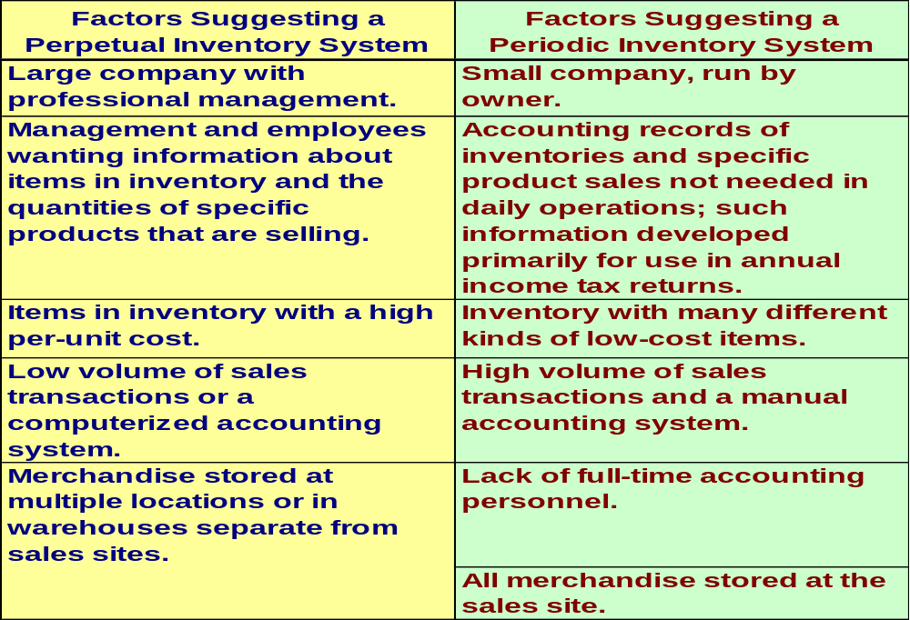
Selecting an Inventory System

